Slide 1


Publicly available
You have been joined in listen only mode with your camera turned off
Live captioning is available in Microsoft Teams
Click on the 3 dots icon / ‘More’
Click ‘Turn on live captions’
ESO Operational Transparency Forum
8 May 2024

Slide 2
Introduction | Sli.do code #OTF
Publicly available
Slido code #OTF
To ask questions live & give us post event feedback go to Sli.do event code #OTF.
  Ask your questions as early as possible as our experts may need time to ensure a correct answer can be given live.
  Please provide your name or organisation. This is an operational forum for industry participants therefore questions from unidentified parties will not be answered live. If you have reasons to remain anonymous to the wider forum please use the advance question or email options below.
  The OTF is not the place to challenge the actions of individual parties (other than the ESO) and we will not comment on these challenges. This type of concern can be reported to the Market Monitoring team at: marketreporting@nationalgrideso.com
  Questions will be answered in the upvoted order whenever possible. We will take questions from further down the list when: the answer is not ready; we need to take the question away or the topic is outside of the scope of the OTF.
  Sli.do will remain open until 12:00, even when the call closes earlier, to provide the maximum opportunity for you to ask questions. After that please use the advance questions or email options below.
  All questions will be recorded and published. Questions which are not answered on the day will be included, with answers, in the slide pack for the next OTF.
  Ask questions in advance (before 12:00 on Monday) at: https://forms.office.com/r/k0AEfKnai3
  Ask questions anytime whether for inclusion in the forum or individual response at: box.NC.customer@nationalgrideso.com
Stay up to date on our webpage: https://www.nationalgrideso.com/OTF (OTF Q&A is published with slidepacks)

Slide 3
Future deep dive / focus topics
Publicly available
Slido code #OTF
Today
Update: Grid Code Development Forum – 8th May
Future
Update on Balancing Reserve – TBC
Advance notice: There will be no OTF on 29th May due to key staff availability over the bank holiday and half term.
If you have suggestions for future deep dives or focus topics please send them to us at: box.NC.customer@nationalgrideso.com and we will consider including them in a future forum

Slide 4
Publicly available
Slido code #OTF
REMA – Scheduling and Dispatch Case for Change Webinar
ESO has been working with consultants AFRY to assess whether there is a ‘Case for Change’ to Scheduling and Dispatch.
We will be running a webinar on 21 May 2024 between 9am and 1pm. This webinar will include interactive breakout sessions throughout the event and a Q&A session at the end for any questions you may have.
The purpose of the webinar is to provide a forum for industry members to present their views and allow direct engagement with AFRY team and ESO colleagues.
The ESO welcomes participation from all areas of Industry.
To keep breakout sessions manageable for the team, we are currently limiting registrations to one person per organisation.
Register here
In advance of the webinar, we recommend that you visit the Net Zero Market Reform website to review the content we have published so far.
If you have any questions, please contact us at: box.Market.Strategy@nationalgrideso.com

Slide 5
NESO Information Request Statement
Publicly available
Slido code #OTF
The Energy Act 2023 and the power to request information.
Section 172 of The Energy Act 2023 provides NESO, as the Independent System Operator and Planner, with the power to require information, from anyone carrying out a relevant activity, to allow it to carry out any of its functions. This power will come into effect once NESO is operational.
In advance of this we are consulting on what the Information Request Statement will contain and what an Information Request issued by NESO may look like.
The Information Request Statement and Notice.
The Statement will be available on our website and will contain sections on why a request has been issued, the process of responding to a request, what happens if a recipient does not provide the information and how we will manage any data provided. A draft template of an Information Request Notice is also shared on our website.
The Consultation
We are running a consultation from May 3rd to May 31st which can be found at https://www.nationalgrideso.com/what-we-do/how-we-operate/information-request-statement-consultation and would welcome feedback from across industry to make sure we develop a statement which is clear and accessible.
Following the consultation period Ofgem will determine if the draft Statement is approved or if any changes are necessary.

Slide 6
Operational Separation Cutover - Billing System Changes
Publicly available
Slido code #OTF
System Outage | What this means to you and your business | Direct questions to email below
TNUoS | No impact. Invoices will be raised as normal for May Variable Direct Debit customer collections will be delayed until restoration of system | Contact here
Connections | No impact. Invoices will be raised as normal for May Variable Direct Debit customer collections will be delayed until restoration of system | Contact here
BSUoS | The last run of BSUoS will be the 25th April. The next run is expected to be 21st May | Contact here
AAHEDC (Hydro) | Invoices will be raised in advance with payment date reflecting the standard due date | Contact here
Settlement providers | Payments will be made earlier than the current published payments calendar. May payments will be made in line with the current billing calendar | Contact here
App Fees | Invoices will be raised before outage if applicable and manually via offline process should this be required | Contact here
As we approach our new role as National Energy System Operator (NESO) this summer, there will be a requirement to update our billing systems. This means that there will be an outage from 26th April to 21st May 2024.
During this we will not be able to produce or send billing information and invoices during this period.
We will share more detailed communications regarding this, including the revised BSUoS calendar shortly.

Slide 7
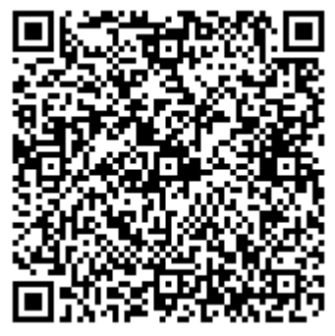
Annual Balancing Costs Report Webinar
Publicly available
Slido code #OTF
Register 17 May
We are pleased to announce details for our first Annual Balancing Cost Report and upcoming webinar.
Date: 17 May 2024
Time: 11:00 – 12:00 PM
Location: Microsoft Teams
The full report will be published on our Balancing Costs webpage on 17 May.
Agenda
Introduction
Key messages
A look back at recent balancing costs
Future balancing cost projections
Audience Q&A
Registration now open for this webinar:
https://events.teams.microsoft.com/event/67a0138a-bf33-44be-b7a1-1a498279106d@f98a6a53-25f3-4212-901c-c7787fcd3495
This webinar will be an opportunity to hear our latest thoughts on recent trends and the future outlook of balancing costs.
If you have any questions or queries in advance, please reach out to box.Balancing.Costs@nationalgrideso.com

Slide 8
Publicly available
Slido code #OTF
The Grid Code Development Forum (GCDF)
The GCDF is a monthly forum that facilitates discussions between the ESO and Industry participants in Grid Code-related matters and potential modifications to the Grid Code.
The forum provides the opportunity to present and discuss potential Grid Code changes, and obtain feedback prior to formal modifications being raised.
The ESO welcomes participation from all areas of Industry.
Deadline for Presentations/Agenda Items | 2024 GCDF Date
29 May | 5 June
26 June | 3 July
31 July | 7 August
28 August | 4 September
25 September | 2 October
30 October | 6 November
27 November | 4 December
You can download the GCDF calendar invites here.
Please contact grid.code@nationalgrideso.com or the GCDF Technical Secretary at David.halford@nationalgrideso.com if you have any questions or would like to present an item for discussion at a future GCDF.

Slide 9
Future Event Summary
Publicly available
Slido code #OTF
Event | Date & Time | Link
FRCR 2024 Consultation | 10th April - 17th May 2024 | Further Information
NESO Information Request Statement Consultation | 3rd May – 31st May 2024 | Further Information
Markets Forum | 14th May 2024 10:00-15:30 | Sign up here
Annual Balancing Cost Report Webinar | 17th May 2024 11:00-12:00 | Sign up here
Scheduling and Dispatch Case for Change Webinar | 21st May 2024 9:00-13:00 | Sign up here
Balancing Programme Webinar | 27th June 2024 9:30-17:30 | Sign up here

Slide 10
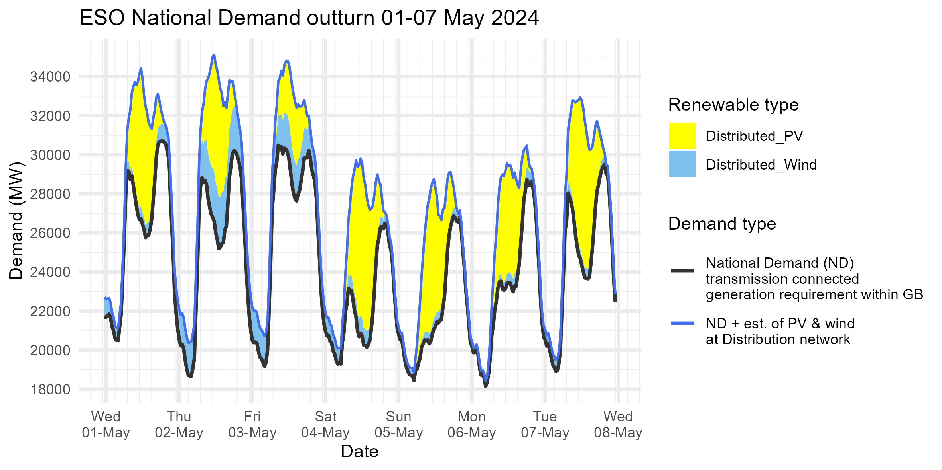
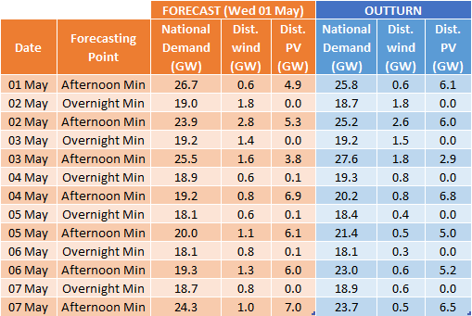
Demand | Last week demand out-turn
Publicly available
Slido code #OTF
The black line (National Demand ND) is the measure of portion of total GB customer demand that is supplied by the transmission network.
ND values do not include export on interconnectors or pumping or station load
Blue line serves as a proxy for total GB customer demand. It includes demand supplied by the distributed wind and solar sources, but it does not include demand supplied by non-weather driven sources at the distributed network for which ESO has no real time data.
Historic out-turn data can be found on the ESO Data Portal in the following data sets: Historic Demand Data & Demand Data Update

Slide 11
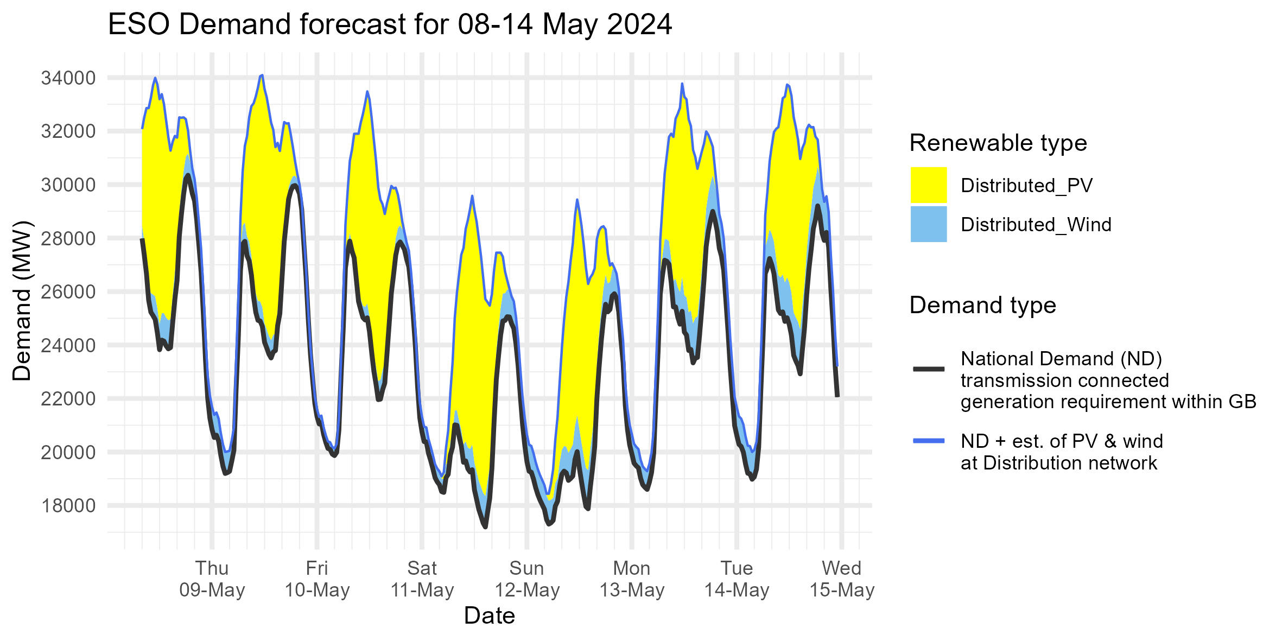
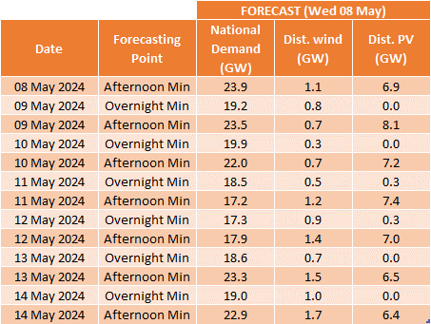
Demand | Week Ahead
Publicly available
Slido code #OTF
The black line (National Demand ND) is the measure of portion of total GB customer demand that is supplied by the transmission network.
ND values do not include export on interconnectors or pumping or station load
Blue line serves as a proxy for total GB customer demand. It includes demand supplied by the distributed wind and solar sources, but it does not include demand supplied by non-weather driven sources at the distributed network for which ESO has no real time data.
Historic out-turn data can be found on the ESO Data Portal in the following data sets: Historic Demand Data & Demand Data Update

Slide 12
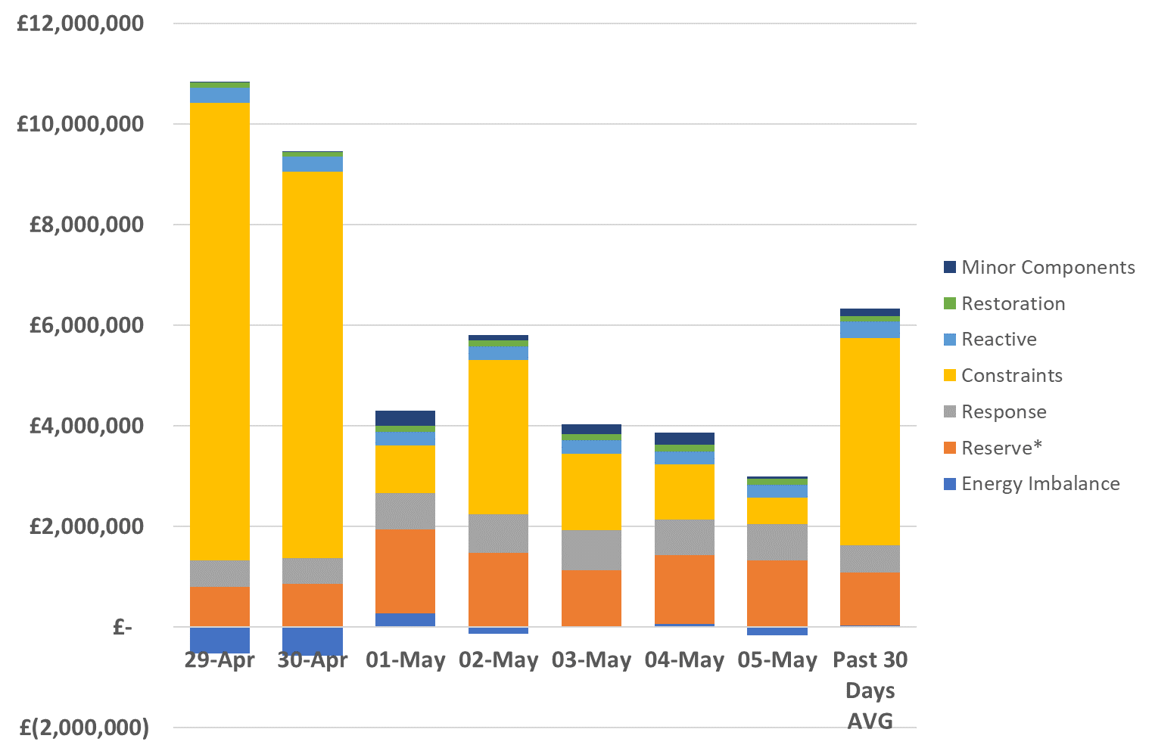
ESO Actions | Category costs breakdown for the last week
Publicly available
Slido code #OTF
Constraints and Reserve costs were the key cost component for the week.
Please note that all the categories are presented and explained in the MBSS.
Data issue: Please note that due to a data issue on a few days over the last few months, the Minor Components line in Non-Constraint Costs is capturing some costs on those days which should be attributed to different categories. It has been identified that a significant portion of these costs should be allocated to the Operating Reserve Category. Although the categorisation of costs is not correct, we are confident that the total costs are correct in all months. We continue to investigate and will advise when we have a resolution.

Slide 13
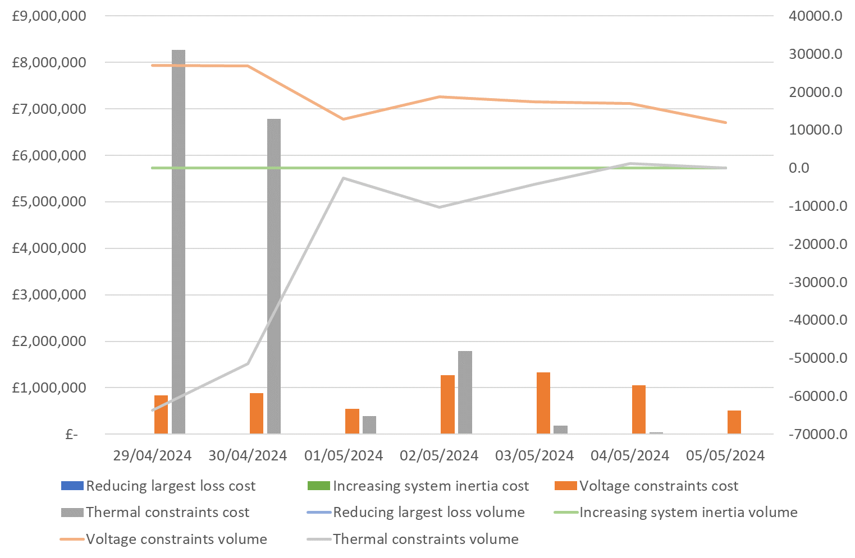
ESO Actions | Constraint Cost Breakdown
Publicly available
Slido code #OTF
Thermal – network congestion
Actions were required to manage thermal constraints throughout the week except for Sunday.
Voltage
Intervention was required to manage voltage levels throughout the week.
Managing largest loss for RoCoF
No intervention was required to manage largest loss.
Increasing inertia
No intervention was required to manage System Inertia this week.

Slide 14
ESO Actions | Wednesday 1 May – Peak Demand – SP spend ~£20k
Publicly available
Slido code #OTF
Carbon Intensity data on data portal: https://www.nationalgrideso.com/data-portal/carbon-intensity-balancing-actions#:~:text=The%20carbon%20intensity%20of%20balancing,profile%20with%20balancing%20actions%20applied.

Slide 15
ESO Actions | Sunday 5 May – Minimum Demand – SP Spend ~£42k
Publicly available
Slido code #OTF
Carbon Intensity data on data portal: https://www.nationalgrideso.com/data-portal/carbon-intensity-balancing-actions#:~:text=The%20carbon%20intensity%20of%20balancing,profile%20with%20balancing%20actions%20applied.

Slide 16
ESO Actions | Monday 29 April – Highest SP Spend ~£361k
Publicly available
Slido code #OTF
Carbon Intensity data on data portal: https://www.nationalgrideso.com/data-portal/carbon-intensity-balancing-actions#:~:text=The%20carbon%20intensity%20of%20balancing,profile%20with%20balancing%20actions%20applied.

Slide 17
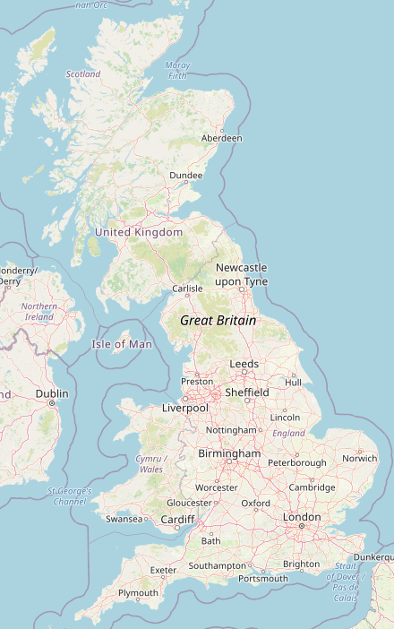
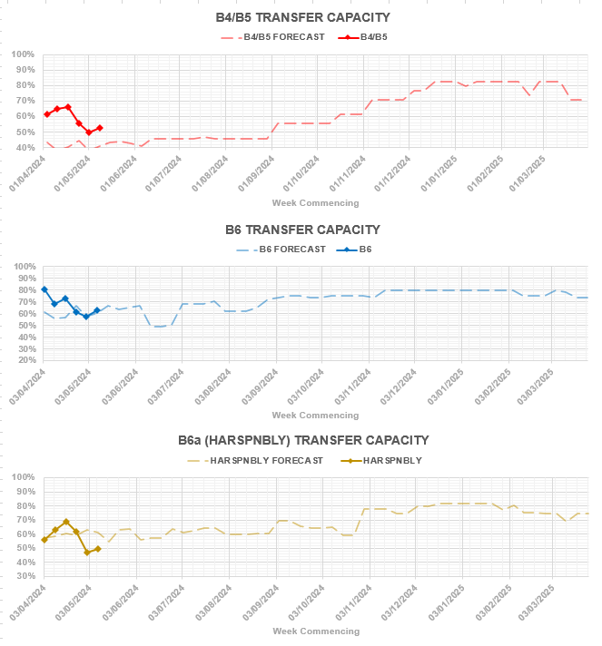
Transparency | Network Congestion
Publicly available
Slido code #OTF
Boundary | Max. Capacity (MW) | Current Capacity (%)
B4/B5 (SSE-SP) | 3400 | 53%
B6 (SCOTEX) | 6800 | 63%
HARSPNBLY | 8000 | 49%
B7 (SSHARN) | 8325 | 89%
GMSNOW | 4700 | 65%
EC5 | 5000 | 100%
LE1 (SEIMP) | 8500 | 68%
B15 (ESTEX) | 7500 | 76%
SC | 7300 | 70%
B4
B5
B6
B6a
B7
B9
GMSNOW
EC5
LE1
B15
SC
Day ahead flows and limits, and the 24-month constraint limit forecast are published on the ESO Data Portal:
Constraints Management

Slide 18
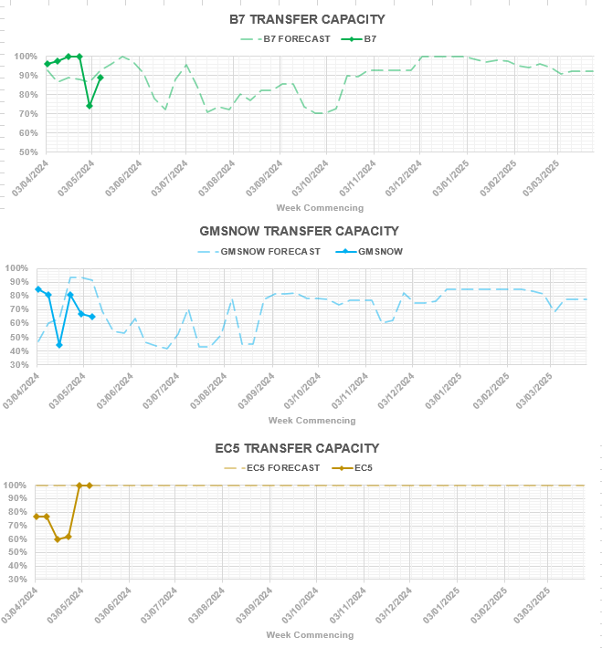
Transparency | Network Congestion
Publicly available
Slido code #OTF
Boundary | Max. Capacity (MW) | Current Capacity (%)
B4/B5 (SSE-SP) | 3400 | 53%
B6 (SCOTEX) | 6800 | 63%
HARSPNBLY | 8000 | 49%
B7 (SSHARN) | 8325 | 89%
GMSNOW | 4700 | 65%
EC5 | 5000 | 100%
LE1 (SEIMP) | 8500 | 68%
B15 (ESTEX) | 7500 | 76%
SC | 7300 | 70%
B4
B5
B6
B6a
B7
B9
GMSNOW
EC5
LE1
B15
SC
Day ahead flows and limits, and the 24-month constraint limit forecast are published on the ESO Data Portal:
Constraints Management

Slide 19
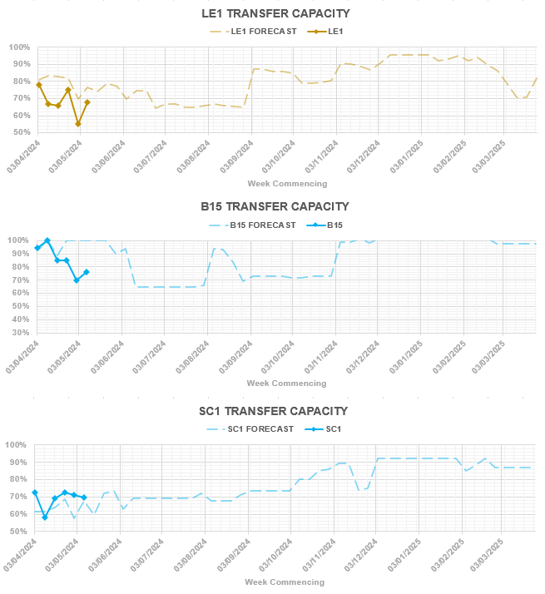
Transparency | Network Congestion
Publicly available
Slido code #OTF
Boundary | Max. Capacity (MW) | Current Capacity (%)
B4/B5 (SSE-SP) | 3400 | 53%
B6 (SCOTEX) | 6800 | 63%
HARSPNBLY | 8000 | 49%
B7 (SSHARN) | 8325 | 89%
GMSNOW | 4700 | 65%
EC5 | 5000 | 100%
LE1 (SEIMP) | 8500 | 68%
B15 (ESTEX) | 7500 | 76%
SC | 7300 | 70%
B4
B5
B6
B6a
B7
B9
GMSNOW
EC5
LE1
B15
SC
Day ahead flows and limits, and the 24-month constraint limit forecast are published on the ESO Data Portal:
Constraints Management

Slide 20
Previously asked questions
Publicly available
Slido code #OTF
Q: For non-firm connections normally NGESO provides the circuits which in case of an outage will result at MW reduced export value. ETYS publish the boundary limits for areas. Could you please confirm whether a boundary flow exceedance (not circuit overload) due to an outage at a circuit in Appendix D are compensated or not as appendix D normally refers to circuits overload. A good example is SC2 Boundary.
A: Fundamentally the principle is that for a non-firm connection, curtailment in line with the connection agreement is not compensated.
Q: For non-firm connections how often the restricted MW value calculated and communicated to customers from National outage planning currently? Is it hourly, daily, weekly task? This influences massively the curtailment percentage. Will NGESO use market mechanisms for project output.
A: The level of restriction associated to a non-firm connection is set in the connection agreement. The ESO does not use market mechanisms to manage non-firm connections.
Q: Most of the EU TOs issue the power system transmission model at least through ENTSO-E publication. Technical data from Appendix B would not allow to create a reliable model as quadratic boosters, taps settings on transformers and voltage control setpoints are not included at the report. Could you please confirm whether there is a plan the model to be shared with parties who have generation subject to curtailment? Without the power system model, the model created by Appendix B will be unreliable without the missing information mentioned above.
A: Currently there is no plan to publish a working model for public consumption. Depending on a generator’s connection point the reason for curtailment could be a wider issue and may not be clear in a particular model.

Slide 21
Previously asked questions
Publicly available
Slido code #OTF
Q: DNO demand - while it may belong to the DNOs can you not ask for it? I don't see how you can take a "whole system view" as NESO without this.
Q: Have you asked the DNOs if you can share the data? I don't see why they would not let you.
A: We do not have access to DNO demand data and have no operational need for the data.
Q: You should be able to provide distribution of demand data by Grid Supply Point as you must have sight of this?
A: We do have demand data by GSP (forecast and actuals) and requests for publication should be directed to: box.OpenData@nationalgrideso.com

Slide 22
Previously asked questions
Publicly available
Slido code #OTF
Q: The answer on slide 22 appears erroneous - the demand, by DNO, at T level is presumably available to ESO (as both metered historic and real time values is available to ENCC) for if it’s not available then how can the T system be operated (as non DNO demand, @ T level, is low)
A: This question refers to this question and answer provided last week (1st May):
  Q: When are we going to get data that is demand by DNO? We need to see actual demand (minus wind and solar) so we can monitor changes caused by EVs, etc.
  A: This data is not available to or owned by the ESO and requests for publication should be directed to the relevant DNO.
The answer provided is correct - we do not have visibility of DNO demand data and currently have no operational need for the data. The principal of Open Data applies equally to DNOs and ESO so the request for this data should be directed to the DNOs.
We do have demand data by GSP (forecast and actuals) and requests for publication should be directed to: box.OpenData@nationalgrideso.com

Slide 23
Advance questions
Publicly available
Slido code #OTF
Q: From the Government’s Strategy and Policy Document that was released today -
(screenshot provided in email)
I take it from this that HMG is expecting the NESO to publish demand data from the DNOs to take a “whole system view”. It would appear Elexon has the settlement data and the DNOs have their own demand data. So what is NGESO doing to get this data published?
I would note the PTE has also been asking for far better data around the DNO systems – both demand and embedded generation – for some years now.
A: We are due to become NESO in summer and we will review the ‘whole system’ data that we consume and publish in due course.
We recognise the theme of DNO data across multiple questions. We will take this away and discuss how we can have a better open dialog with anyone interested in this topic.

Slide 24
Advance questions
Publicly available
Slido code #OTF
Q: Would it be possible to give an explanation other than 'OBP despatches most economically' as to why batteries appear to be despatched in the BM completely outwith price order on ocassion - as dynamics seem to be very similar and none of the BOA's are 'system' flagged there must be some other reason? e.g. E_Chapb-1 bid at £43 / £33 while other batteries available at £50+ not touched and E_Arbrb-1 offered at £105 while cheaper batteries available ,again, not touched. (P24 on 7th May) I know you don't comment on individual assets so am not looking for you to explain the specific examples mentioned, more trying to understand why these sorts of actions are being taken - all to do with ancilliary contracts / OBP not working properly / something else?

Slide 25
Reminder about answering questions at the ESO OTF
Publicly available
Slido code #OTF
Questions from unidentified parties will not be answered live. If you have reasons to remain anonymous to the wider forum please use the advance question or email options. Details in the appendix to the pack.
The OTF is not the place to challenge the actions of individual parties (other than the ESO) and we will not comment on these challenges. This type of concern can be reported to the Market Monitoring team at: marketreporting@nationalgrideso.com
Questions will be answered in the upvoted order whenever possible. We will take questions from further down the list when: the answer is not ready; we need to take the question away or the topic is outside of the scope of the OTF.
Slido will remain open until 12:00, even when the call closes earlier, to provide the maximum opportunity for you to ask questions.
All questions will be recorded and published All questions asked through Sli.do will be recorded and published, with answers, in the Operational Transparency Forum Q&A on the webpage: https://www.nationalgrideso.com/what-we-do/electricity-national-control-centre/operational-transparency-forum
Takeaway questions – these questions will be included in the pack for the next OTF, we may ask you to contact us by email in order to clarify or confirm details for the question.
Out of scope questions will be forwarded to the appropriate ESO expert or team for a direct response. We may ask you to contact us by email to ensure we have the correct contact details for the response. These questions will not be managed through the OTF, and we are unable to forward questions without correct contact details. Information about the OTF purpose and scope can be found in the appendix of this slide pack

Slide 26
Publicly available
slido
Audience Q&A Session
ⓘ Start presenting to display the audience questions on this slide.

Slide 27
Feedback
Publicly available
Slido code #OTF
Please remember to use the feedback poll in sli.do after the event.
We welcome feedback to understand what we are doing well and how we can improve the event for the future.
If you have any questions after the event, please contact the following email address: box.NC.Customer@nationalgrideso.com

Slide 28
Publicly available
Appendix

Slide 29
Participation in the Operational Transparency Forum
Publicly available
Slido code #OTF
Thank you to everyone who participates in the OTF, whether you join weekly, monthly, on specific occasions or follow up with the webinar recordings and published slides. We hear from participant feedback and our ESO colleagues that all of us value the opportunity to share information, ask questions and share the answers.
One of the reasons this format works so well is the professional courtesy we see demonstrated every week.
However, in recent weeks there have been some Slido questions and comments in the Q&A session directed at specific market participants suggesting their actions are not appropriate. This is concerning because:
The statements are being made in a public forum without the opportunity to reply
The negative comments may impact these businesses directly, or indirectly e.g.: through social media, etc.
The individuals asking questions could not be traced using the details provided in Slido
The OTF is not the place to challenge the actions of individual parties (other than the ESO) and we will not comment on these challenges. This type of concern can be reported to the Market Monitoring team at: marketreporting@nationalgrideso.com
Remember, if you have reasons to remain anonymous to the wider forum, or have concerns your question may not be one to ask in public, you can use the advance questions or email options.

Slide 30
Purpose and scope of the ESO Operational Transparency Forum
Slido code #OTF
Purpose
The Operational Transparency Forum runs once a week to provide updated information on and insight into the operational challenges faced by the control room in the recent past (1-2 weeks) and short term future (1-2 weeks). The OTF will also signpost other ESO events, provide deep dives into focus topics, and allow industry to ask questions.
Scope
Aligns with purpose, see examples below:
In Scope of OTF |  | Out of Scope of OTF
Material presented i.e.: regular content, deep dives, focus topics ESO operational approach & challenges ESO published data |  | Data owned and/or published by other parties e.g.: BMRS is published by Elexon Processes including consultations operated by other parties e.g.: Elexon, Ofgem, DESNZ Data owned by other parties Details of ESO Control Room actions & decision making Activities & operations of particular market participants ESO policy & strategic decision making Formal consultations e.g.: Code Changes, Business Planning, Market development

Slide 31
Managing questions at the ESO Operational Transparency Forum
Slido code #OTF
OTF participants can ask questions in the following ways:
  Live via Slido code #OTF
  In advance (before 12:00 on Monday) at https://forms.office.com/r/k0AEfKnai3
  At any time to box.NC.Customer@nationalgrideso.com
All questions asked through Sli.do will be recorded and published, with answers, in the Operational Transparency Forum Q&A on the webpage: Operational Transparency Forum | ESO (nationalgrideso.com)
Advance questions will be included, with answers, in the slide pack for the next OTF and published in the OTF Q&A as above.
Email questions which specifically request inclusion in the OTF will be treated as Advance questions, otherwise we will only reply direct to the sender.
Takeaway questions – we may ask you to contact us by email in order to clarify or confirm details for the question.
Out of scope questions will be forwarded to the appropriate ESO expert or team for a direct response. We may ask you to contact us by email to ensure we have the correct contact details for the response. These questions will not be managed through the OTF, and we are unable to forward questions without correct contact details. Information about the OTF purpose and scope can be found in the appendix of this slide pack

